Slide 1
Non-Native Discrimination of Vowels, Consonants, and Phonemic Length Is Better Predicted By Perceptual Similarity Than By Perceptual Assimilation Category Types
Danielle Daidone, Franziska Kruger, Ryan Lidster
^{Indiana University}
New Sounds, Waseda University, Tokyo, August 31, 2019

Slide 2
Predicting Non-native Discriminability
Models about the acquisition of L2 phonology predict what sounds are easy/difficult for L2 learners
SLM: Flege, 1995; PAM-L2: Best & Tyler, 2007; L2LP: Escudero, 2005
Predictions are very general
  PAM-L2: two “uncategorized” sounds will be discriminated “poorly to moderately well” depending on similarity to L1 phonemes
  SLM: new category can be established if bilinguals "discern at least some phonetic differences" between L2 sound and closest L1 sound
Need for experimental methods to make more specific predictions
Notes:
Theoretical frameworks address this, but those give big picture hypotheses. For specific contrasts, how do we predict discriminability?
- Need for experimental methods to make specific predictions about how difficult it will be for foreign language learners to discriminate sounds

Slide 3
Perceptual Assimilation (PA) Task & its limitations
Non-native sounds categorized as L1 sounds and rated as good/bad exemplar
  Need to decide what L1 labels to provide, how to label phenomena not present in L1 (e.g., tone, length)
Results typically reported as categorization types: e.g., two category, single category, category goodness (Best, 1995; Best & Tyler, 2007)
Cutoff thresholds for "categorized" differ:
  50%, 70%, 90% (Faris et al., 2016, Tyler et al., 2014, Harnsberger, 2001)
Notes:
Listeners categorize non-native sounds as L1 sounds and rate how good of an example it is of that native sound
Relationship of non-native to native sounds typically reported as categorization types (Best, 1995; Best & Tyler, 2007):
Uncategorized = where one or more non-native sounds were not categorized consistently enough as one L1 sound to meet some threshold

Slide 4
Alternative Analysis for PA task
Alternative analysis: overlap scores compare non-native sounds to each other (Levy, 2009):
  How often two non-native phonemes are categorized as the same native categories
  Objective formula, fully reproducible and usable for any type of forced-choice identification task
  The greater the overlap, the more difficult the contrast
Departs from original PAM(-L2) theory
  Does not take goodness ratings into account
  Makes no reference to L1 categories

Slide 5
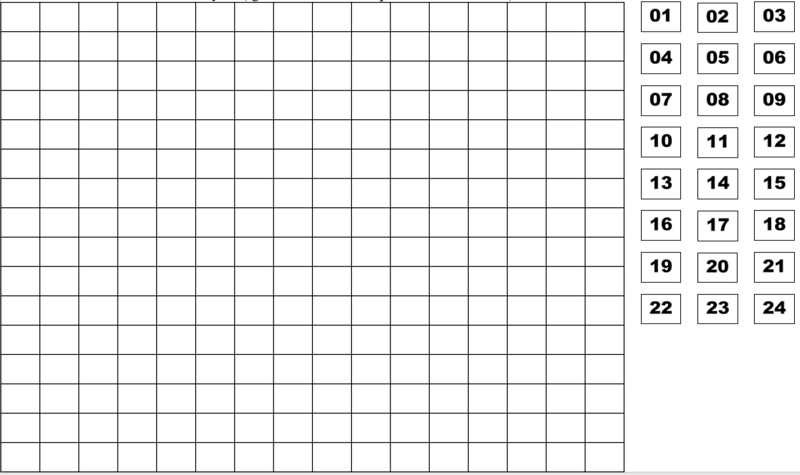
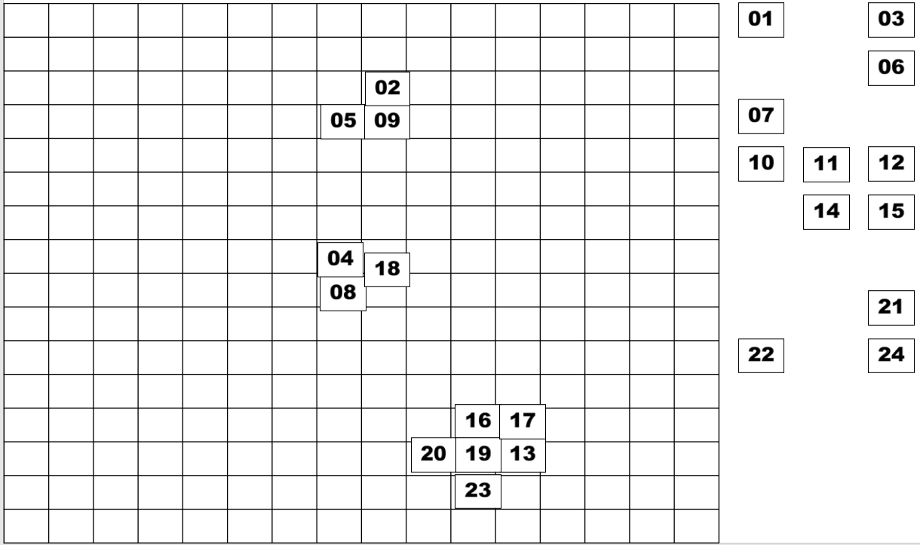
Alternative Task:
Free Classification (FC) Task
One type of similarity judgment task commonly used in dialect and accent perception (Atagi & Bent, 2013; Clopper, 2008)
Participants are presented with all non-native stimuli together, and make groups of sounds they think sound similar to each other
No researcher-imposed labels, no explicit reference to L1 categories, can be used with any speech phenomenon

Slide 6
Study Motivation
When Perceptual Assimilation (PA) tasks have been compared against discrimination performance, results have been mixed (e.g. Harnsberger, 2001; Tyler et al., 2014)
Overlap scores seem promising (Levy, 2009), but so far no comparison to other methods
Free Classification (FC) tasks have rarely been used for sounds (cf. Daidone, Kruger, Lidster, 2015) and not been compared against discrimination results
Notes:
Harnsberger: among SC assimilation types alone, accuracy scores on a discrimination task ranged from 32% to 95%

Slide 7
The Current Study
Compares different methods of predicting discriminability to observed accuracy scores on Oddity (and AXB) tasks
  Perceptual Assimilation Task
    Categorization types
    Overlap scores (Goodness-weighted)
  Free Classification Task
    Grouping rates
    Multi-Dimensional Scaling (MDS) distances

Slide 8
Participants
Large vowel inventory → Large vowel inventory
Small vowel inventory → Small vowel inventory
German vowels: 61 AE-speaking participants
11 vowel contrasts
Finnish vowels: 21 participants from central Japan
10 vowel contrasts
Consonants
Non-segmental
Arabic consonants: 13 AE-speaking participants
10 consonant contrasts
Finnish length: 28 AE-speaking & 29 Japanese-speaking participants
8 length contrasts (vowels & consonants)
AE=American English

Slide 9
Materials and Procedure
Consent form and Hearing Screening
Free Classification
Language Background Questionnaire
Discrimination task: Oddity (German vowels: also AXB)
Perceptual Assimilation Task (Finnish length: Identification)

Slide 10
Stimuli
German vowel contrasts: 11 contrasts
2 contexts: /ʃtVt/, /skVk/ (e.g., skuk-skyk)
Finnish vowels: 10 contrasts
2 contexts: /tVhVt/, /kVhVk/ (e.g., tuhut-tyhyt)
1 | u ~ y | 7 | ɪ ~ ɛ
2 | u ~ o | 8 | ɪ ~ ʏ
3 | y ~ ø | 9 | e ~ ɛ
4 | o ~ e | 10 | e ~ a
5 | i ~ e | 11 | ø ~ ʏ
6 | i ~ a
1 | u ~ y | 6 | æ ~ ɑ
2 | y ~ ø | 7 | ɑ ~ o
3 | u ~ ø | 8 | e ~ æ
4 | o ~ ø | 9 | e ~ I
5 | e ~ ø | 10 | ɑ ~ i
Arabic consonants: 10 contrasts
3 contexts: /taCa/, /tiCi/, /tuCu/ (e.g., taka-taqa)
Finnish length : 8 contrasts
3 contexts: /pata/, /tiki/, /kupu/ (e.g., pata-patta)
1 | k ~ q | 6 | k ~ x
2 | h ~ ʕ | 7 | ɣ ~ ʕ
3 | x ~ ɣ | 8 | ħ ~ x
4 | ʕ ~ ʔ | 9 | k ~ h
5 | h ~ x | 10 | h ~ ħ
1 | cVcV-cVccV | 5 | cVccVV-cVVcVV
2 | cVcV-cVVcV | 6 | cVVcV-cVVccV
3 | cVccV-cVVcV | 7 | cVVcVV-cVVccVV
4 | cVVcV-cVcVV | 8 | cVVccV-cVVccVV

Slide 11
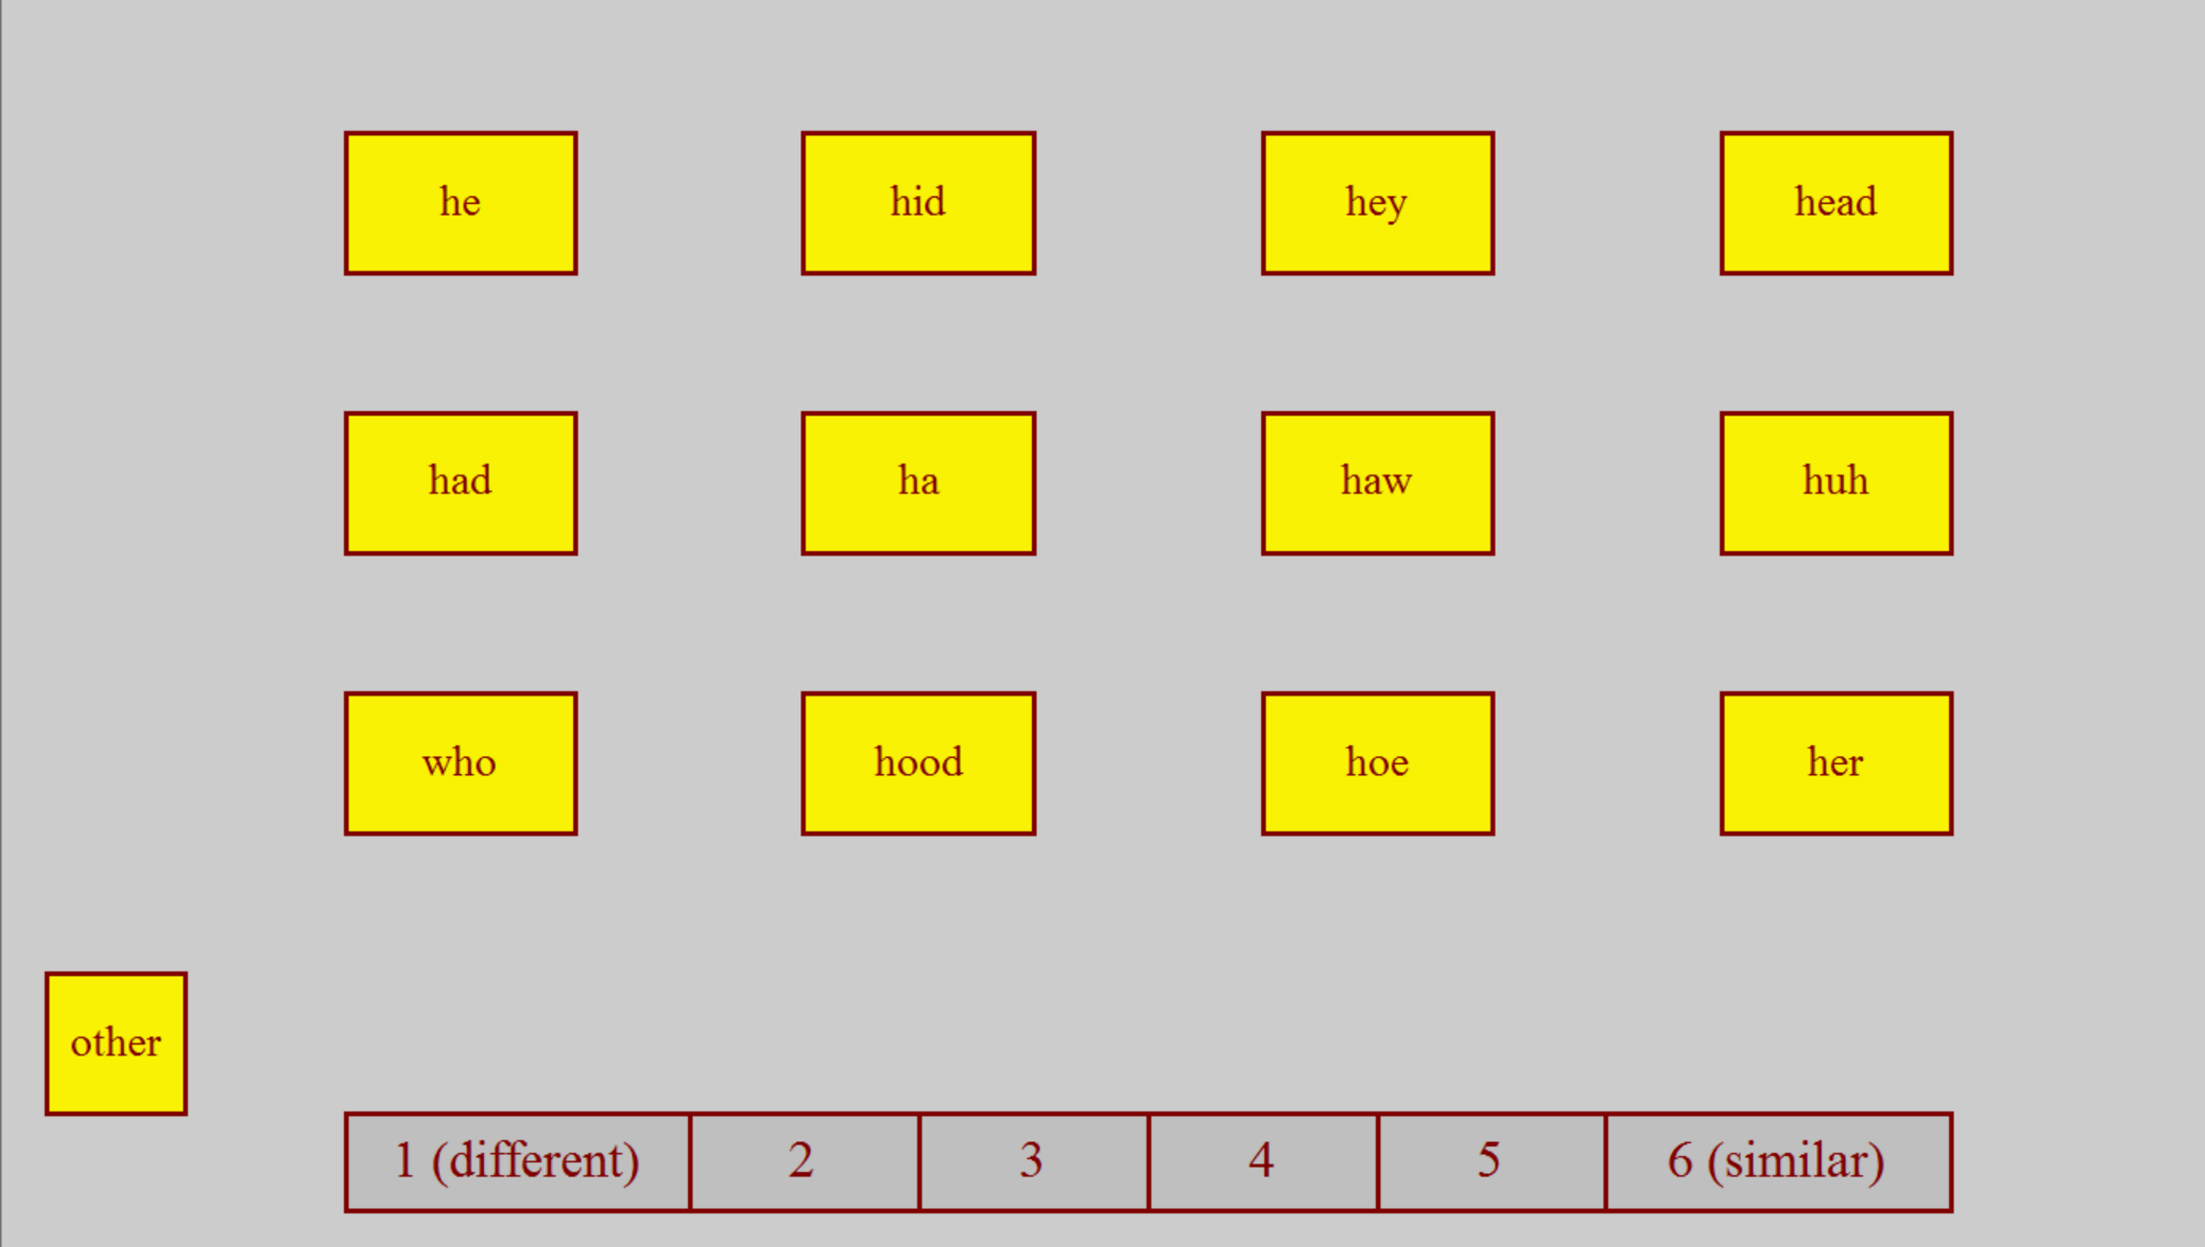
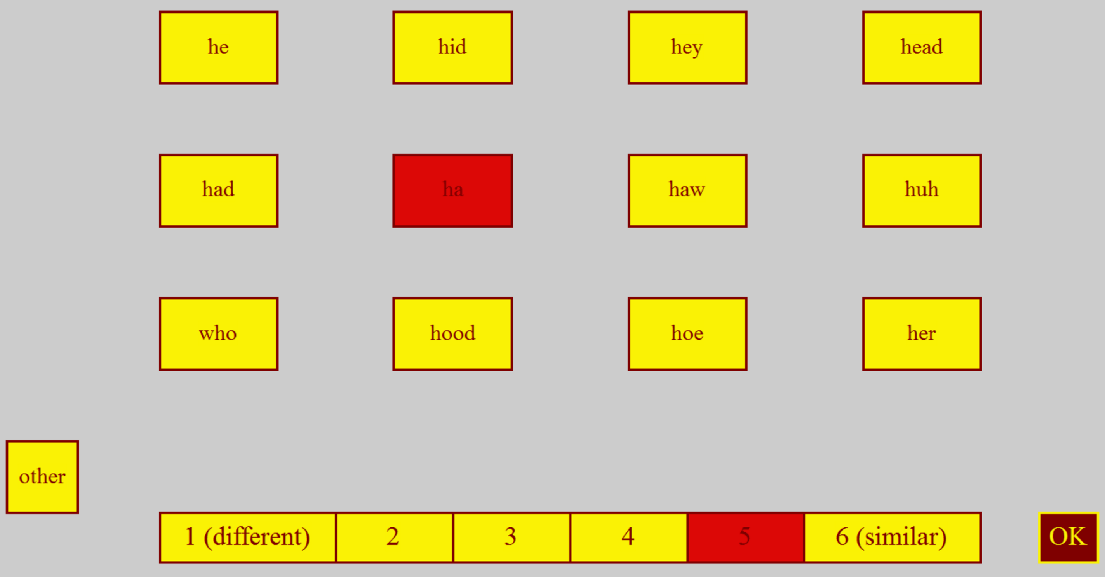
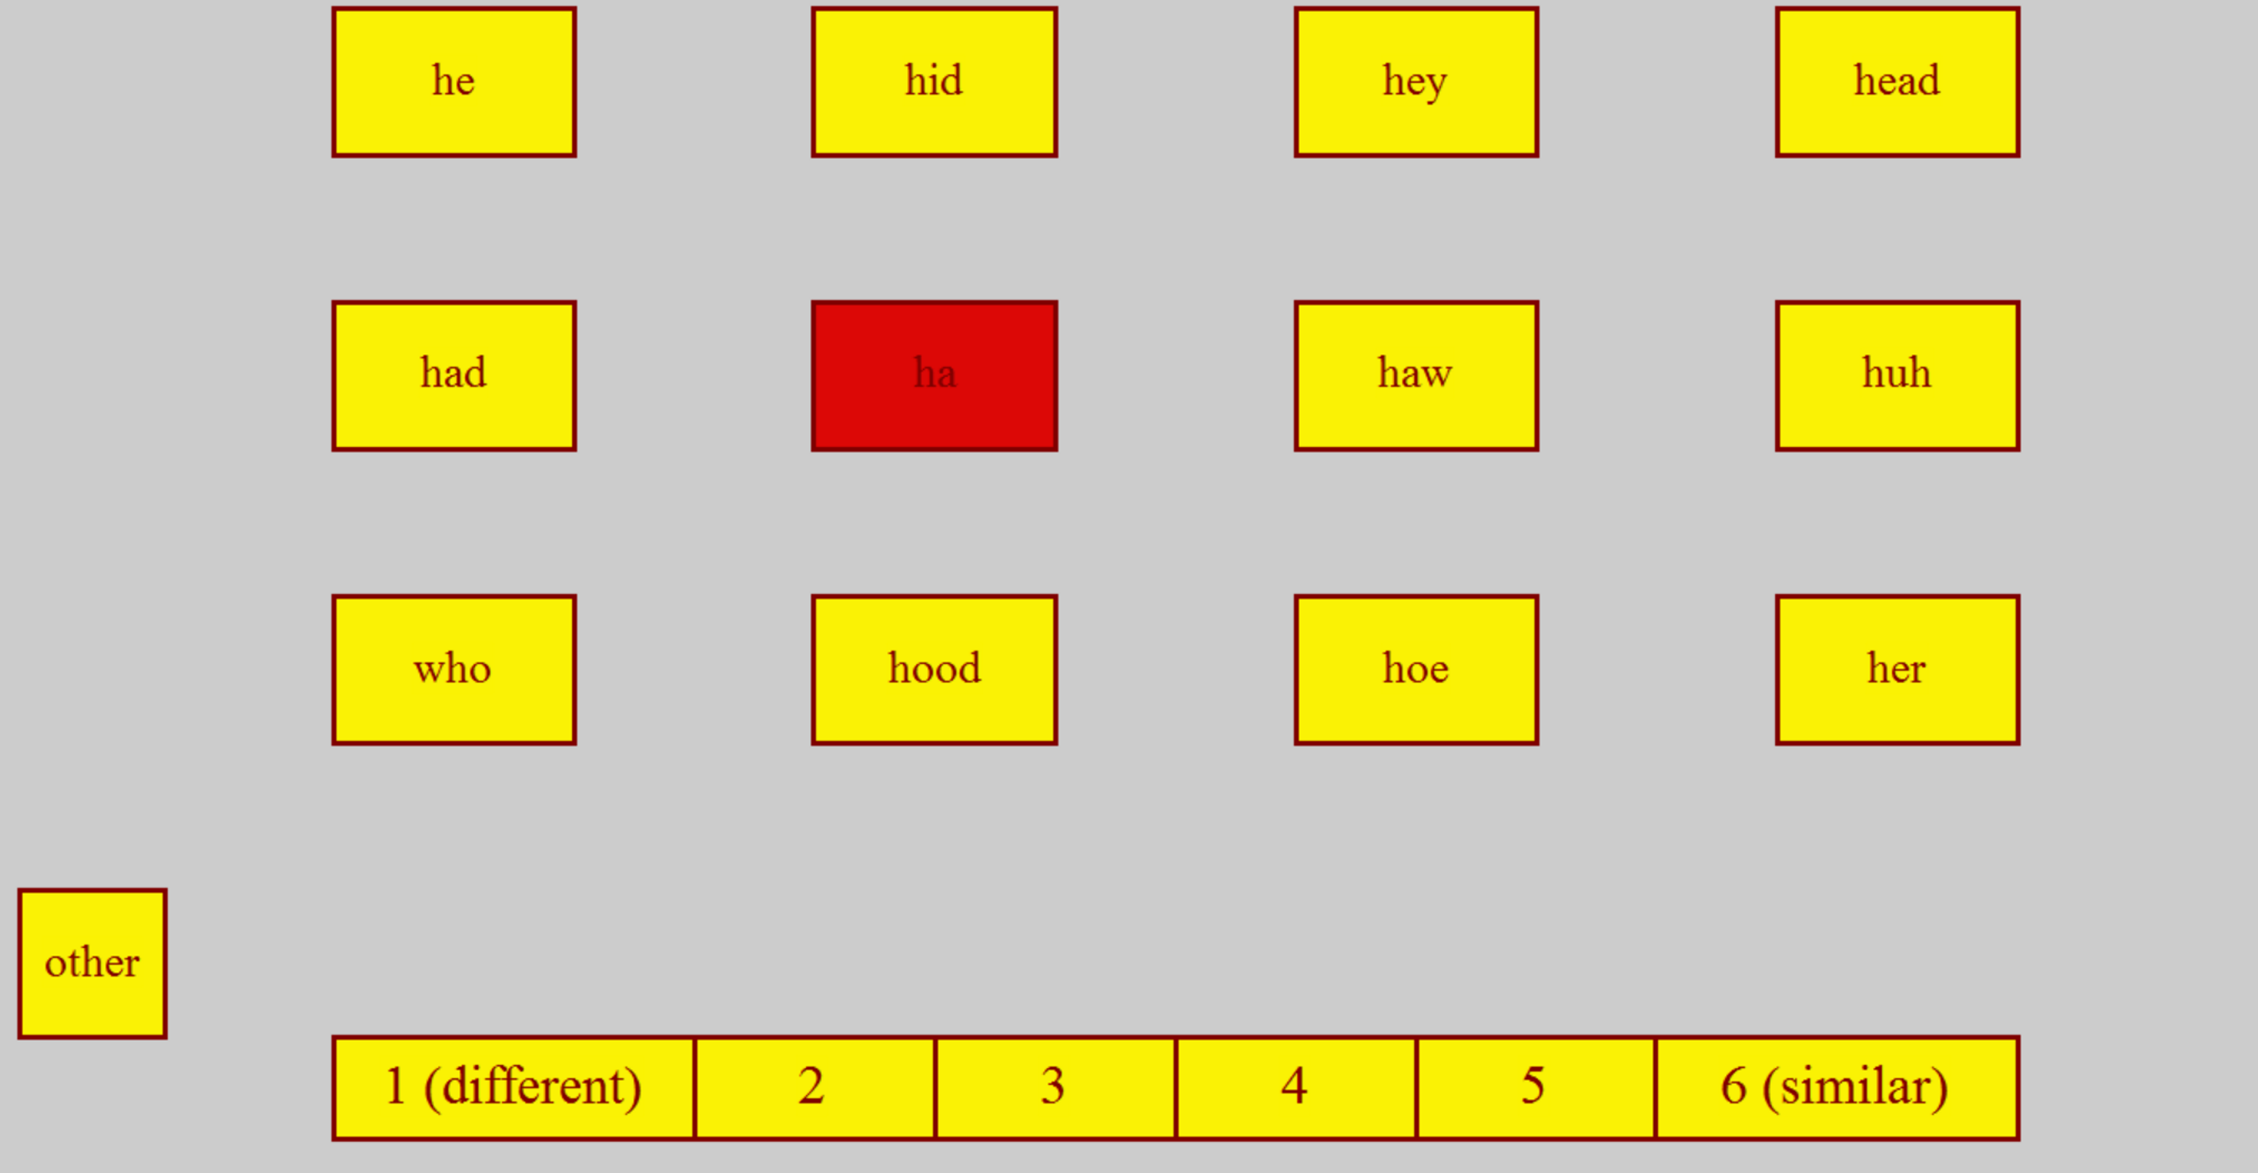
Perceptual Assimilation
Instructions: Click the vowel that is most similar to the one you heard. Then decide how similar or different the vowel was.
Familiarization → Training → Check
Conducted in Praat or jsPsych, depending on the experiment

Slide 12
Results: Perceptual Assimilation (German Vowels)
Combined Total |  | AE Vowel
 |  | he i | hid ɪ | hey eɪ | head ɛ | had æ | huh ʌ | her ɝ | ha ɑ | haw ɔ | hoe oʊ | hood ʊ | who u | other
German Vowel | i | 92.5 | 3.6 | 1.4 | 1.8 | 0.1 | 0.0 | 0.1 | 0.0 | 0.0 | 0.0 | 0.0 | 0.0 | 0.4
 | ɪ | 4.2 | 69.9 | 11.3 | 12.9 | 0.1 | 0.0 | 0.2 | 0.1 | 0.0 | 0.0 | 0.3 | 0.1 | 0.9
 | e | 22.2 | 18.3 | 46.9 | 9.6 | 0.2 | 0.0 | 0.4 | 0.2 | 0.0 | 0.0 | 0.2 | 0.4 | 1.4
 | ɛ | 2.8 | 2.3 | 10.8 | 81.7 | 0.2 | 0.2 | 0.9 | 0.0 | 0.1 | 0.1 | 0.0 | 0.0 | 1.0
 | a | 0.1 | 0.0 | 0.0 | 1.3 | 5.6 | 45.9 | 0.0 | 35.2 | 10.3 | 0.4 | 0.2 | 0.2 | 0.6
 | o | 0.0 | 0.0 | 0.0 | 0.0 | 0.1 | 1.4 | 0.2 | 2.6 | 35.8 | 37.9 | 12.5 | 5.8 | 3.7
 | ø | 0.0 | 0.3 | 0.6 | 0.2 | 0.1 | 12.1 | 6.3 | 0.0 | 0.3 | 1.4 | 61.5 | 15.8 | 1.3
 | u | 0.1 | 0.0 | 0.0 | 0.0 | 0.0 | 0.4 | 0.0 | 0.2 | 1.5 | 1.1 | 17.8 | 77.6 | 1.2
 | y | 0.3 | 0.5 | 0.4 | 0.0 | 0.0 | 2.0 | 0.2 | 0.0 | 0.2 | 0.1 | 21.9 | 72.0 | 2.3
 | ʏ | 0.1 | 2.5 | 0.0 | 0.6 | 0.1 | 20.0 | 2.5 | 0.2 | 0.3 | 0.2 | 67.4 | 4.6 | 1.5
With 50% threshold: Two-Category
With 70% threshold: Categorized-Uncategorized
With 90% threshold: Uncategorized-Uncategorized

Slide 13
Calculating Overlap Scores (Levy, 2009)
Combined Total |  | AE Vowel
 |  | he i | hid ɪ | hey eɪ | head ɛ | had æ | huh ʌ | her ɝ | ha ɑ | haw ɔ | hoe oʊ | hood ʊ | who u
German Vowel | ɪ | 4.2 | 69.9 | 11.3 | 12.9 | 0.1 | 0.0 | 0.2 | 0.1 | 0.0 | 0.0 | 0.3 | 0.1
 | e | 22.2 | 18.3 | 46.9 | 9.6 | 0.2 | 0.0 | 0.4 | 0.2 | 0.0 | 0.0 | 0.2 | 0.4
How similarly were German vowels categorized overall
  Example: /ɪ/~/e/
→ 4.2 + 18.3 + 11.3
+ … = 44.8%

Slide 14
Overlap Scores
Essentially, this analysis converts PA results to a type of similarity judgment

Slide 15
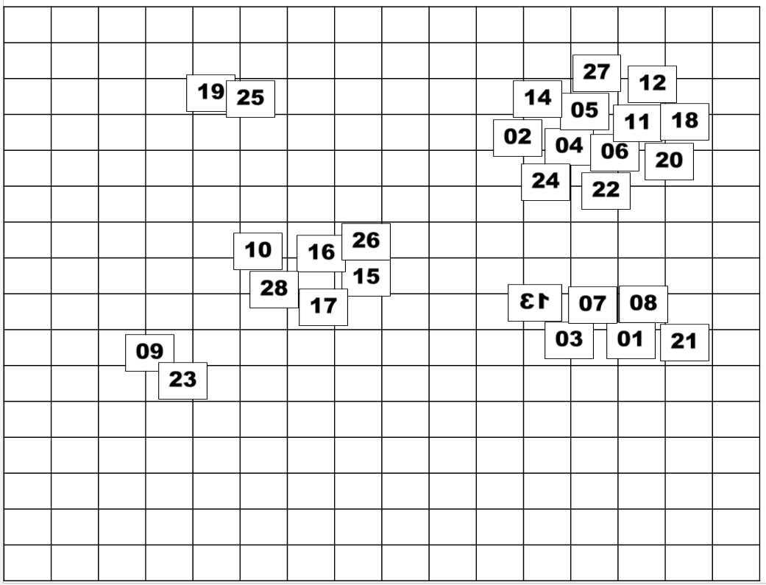
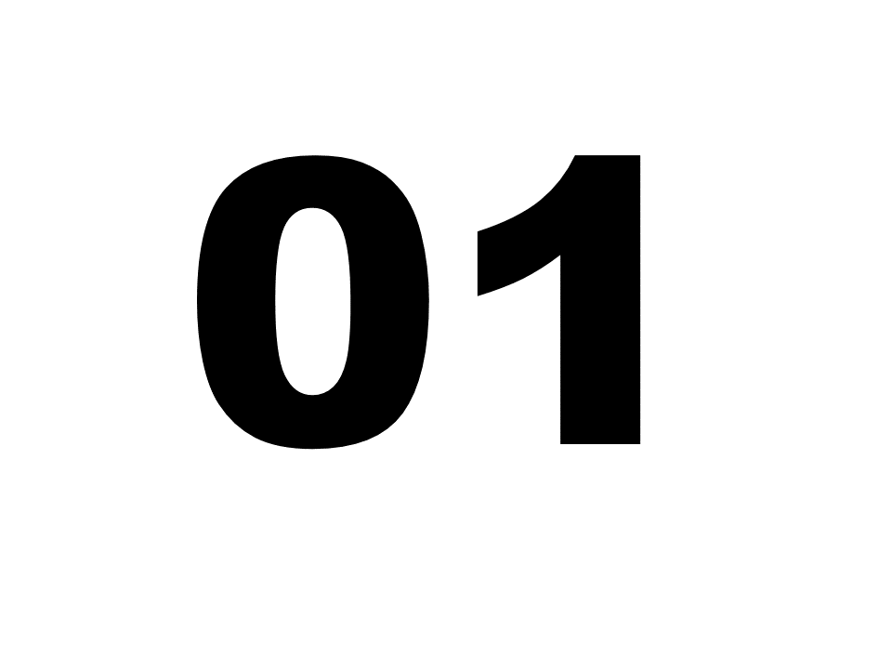
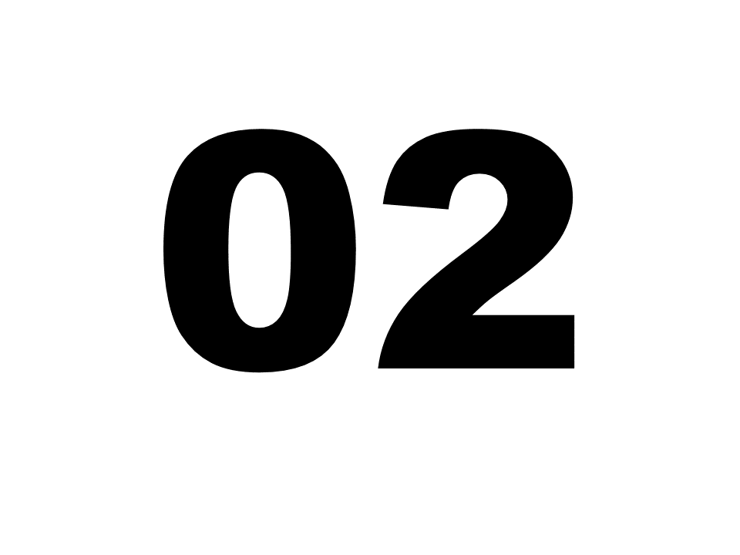
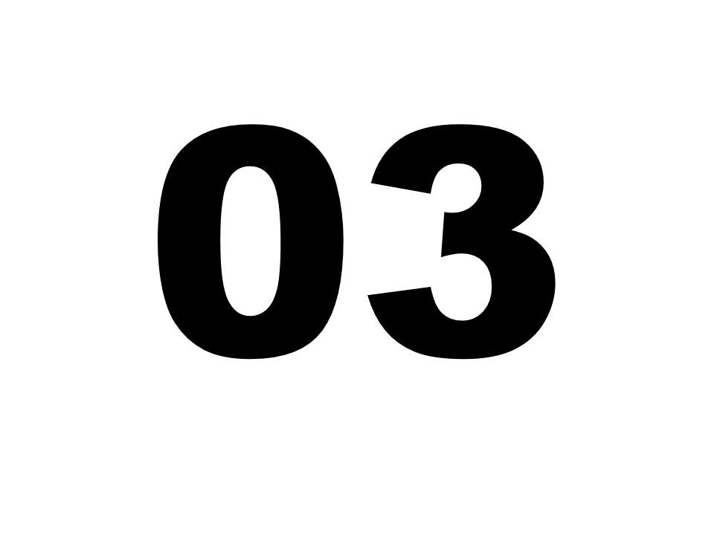
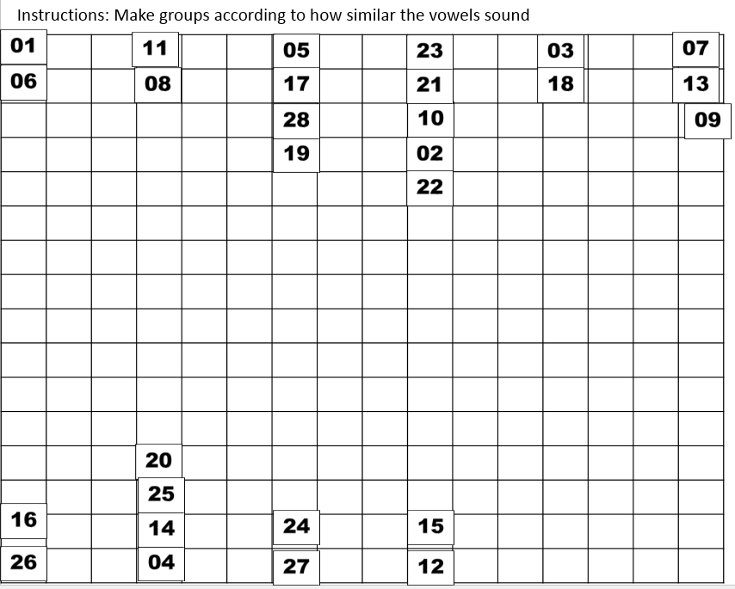
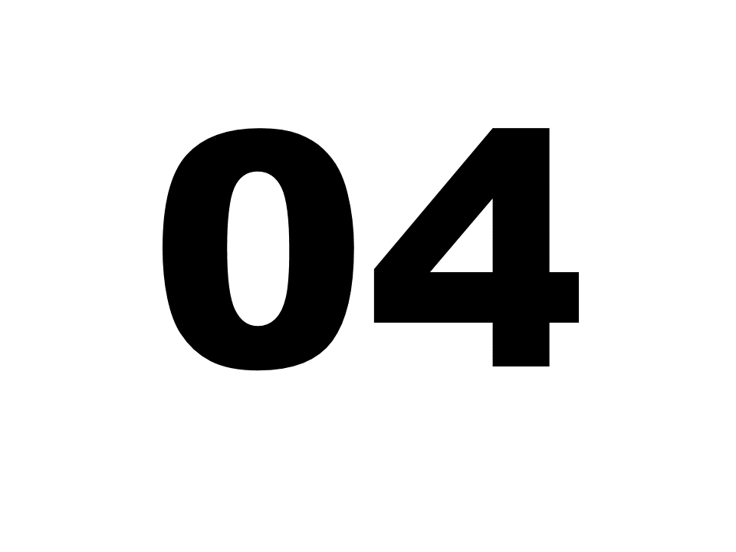
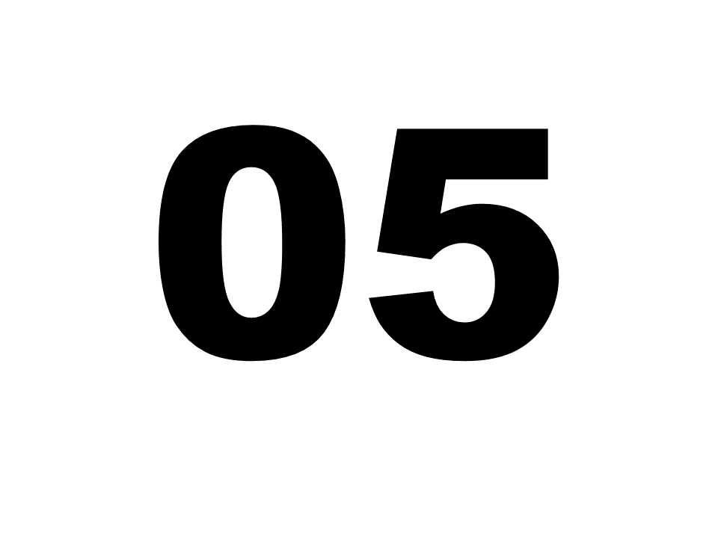
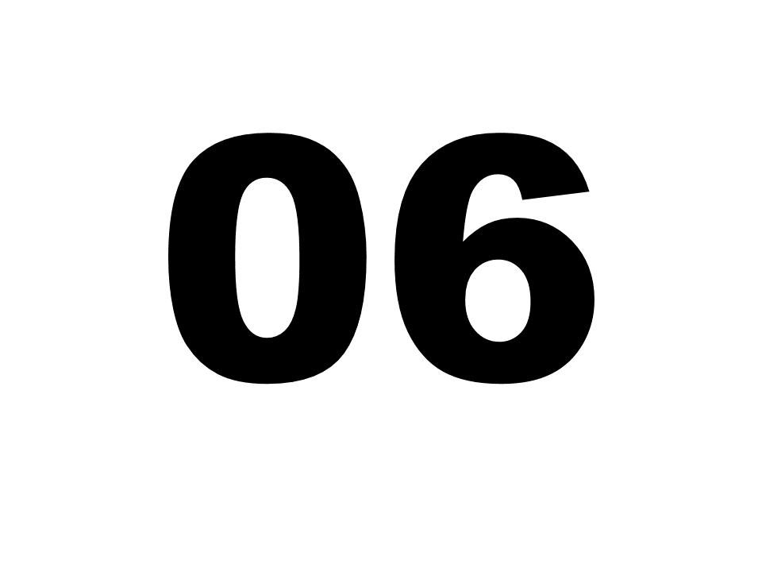
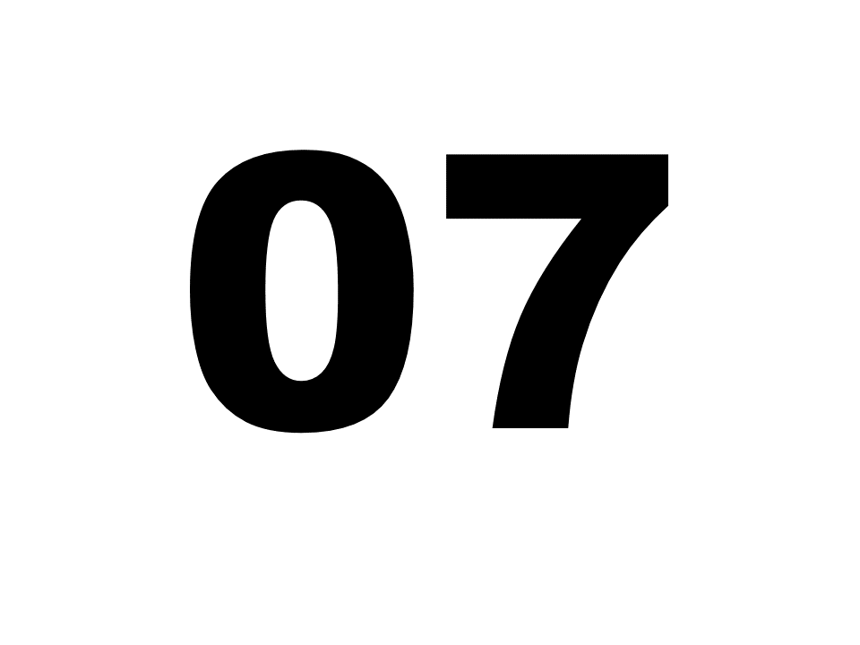
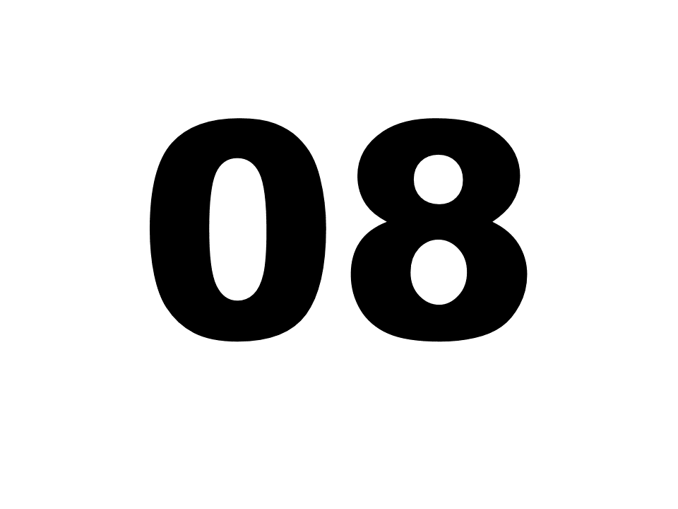
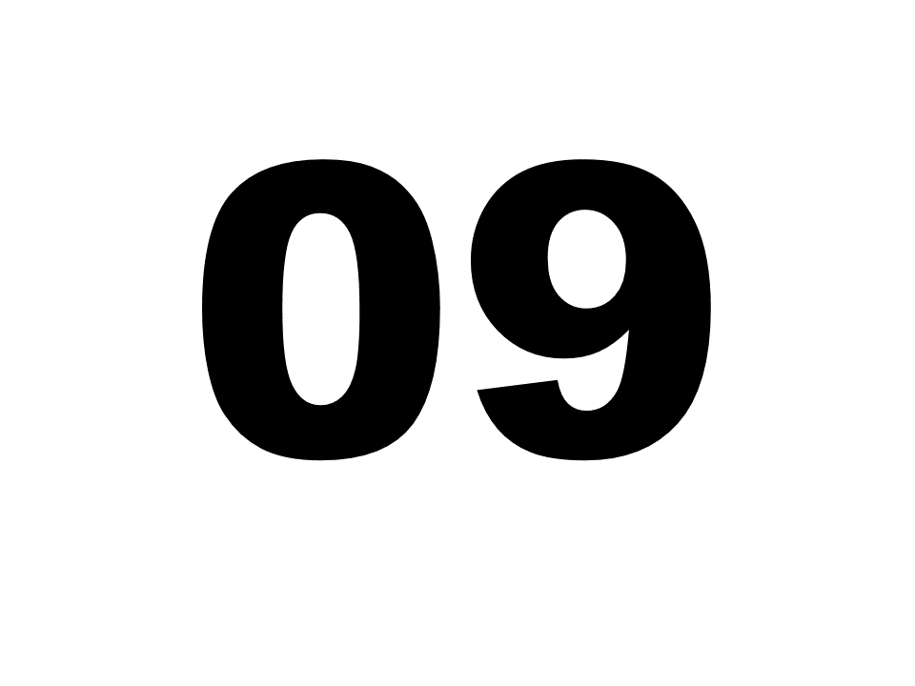
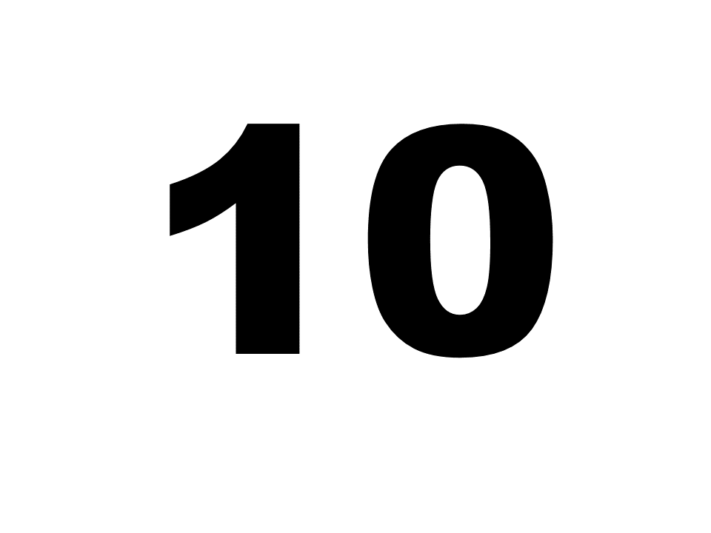
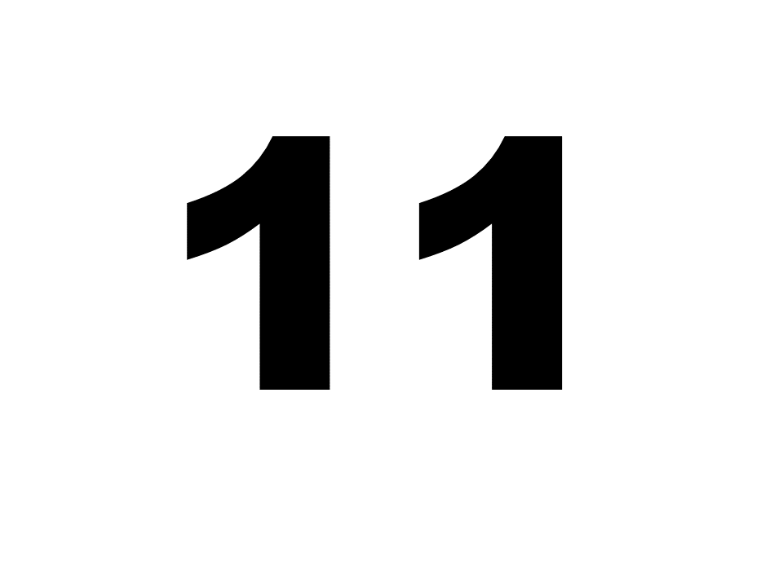
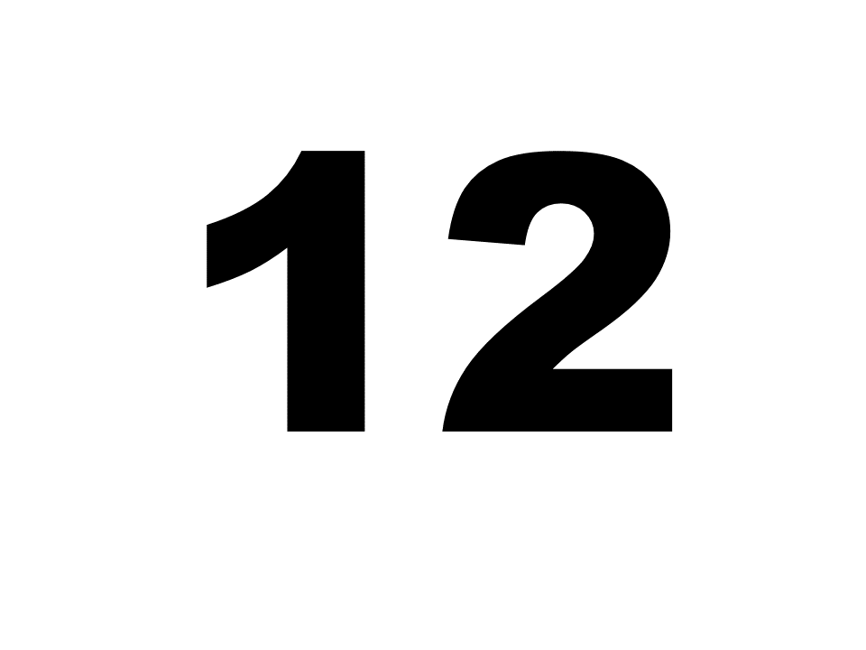
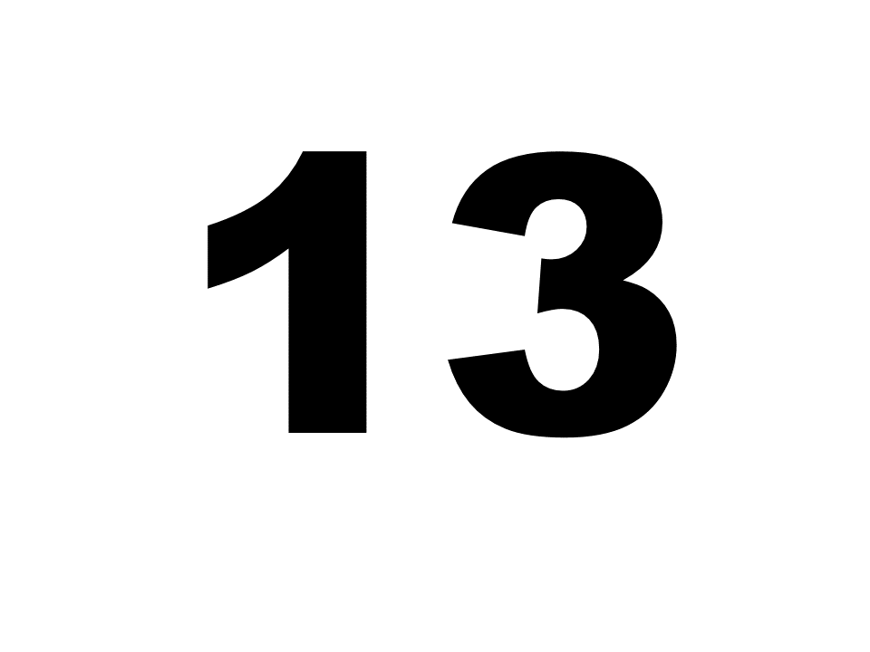
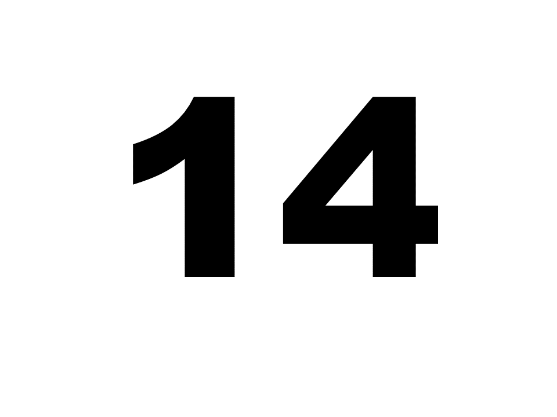
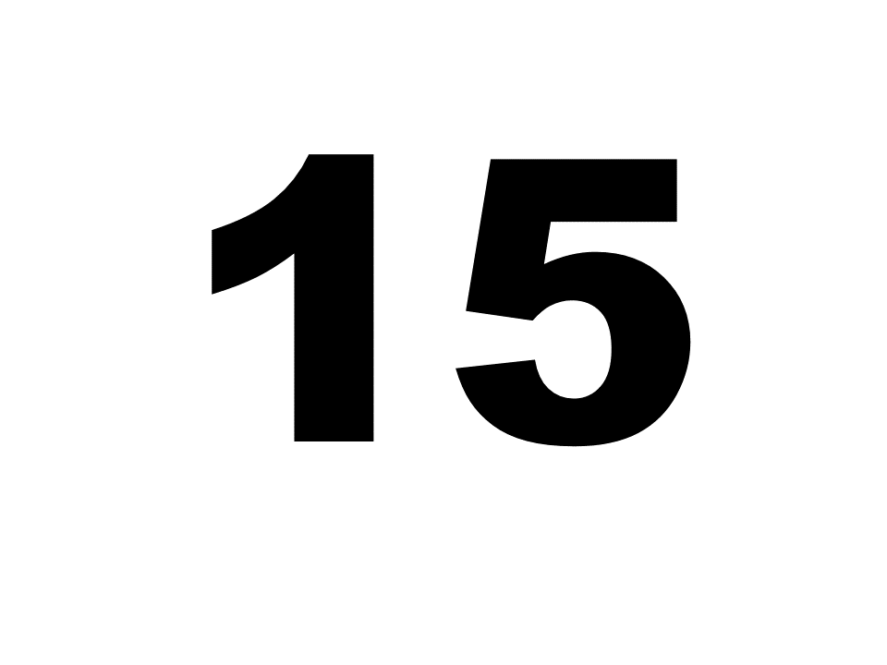
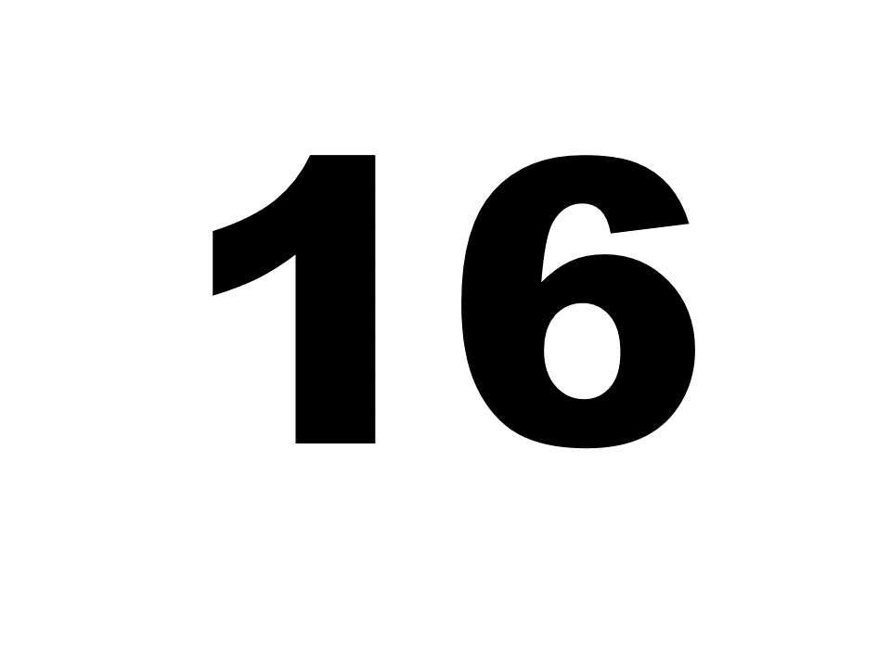
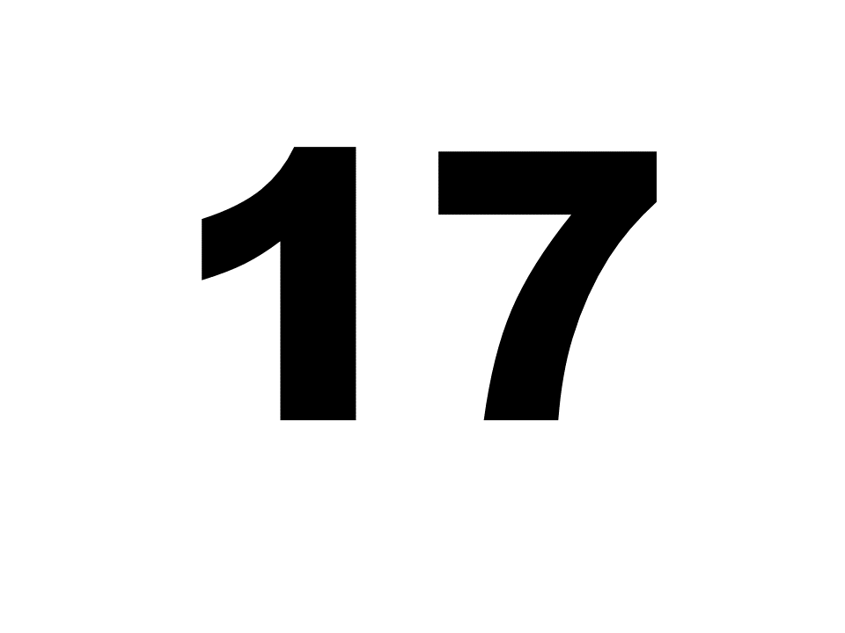
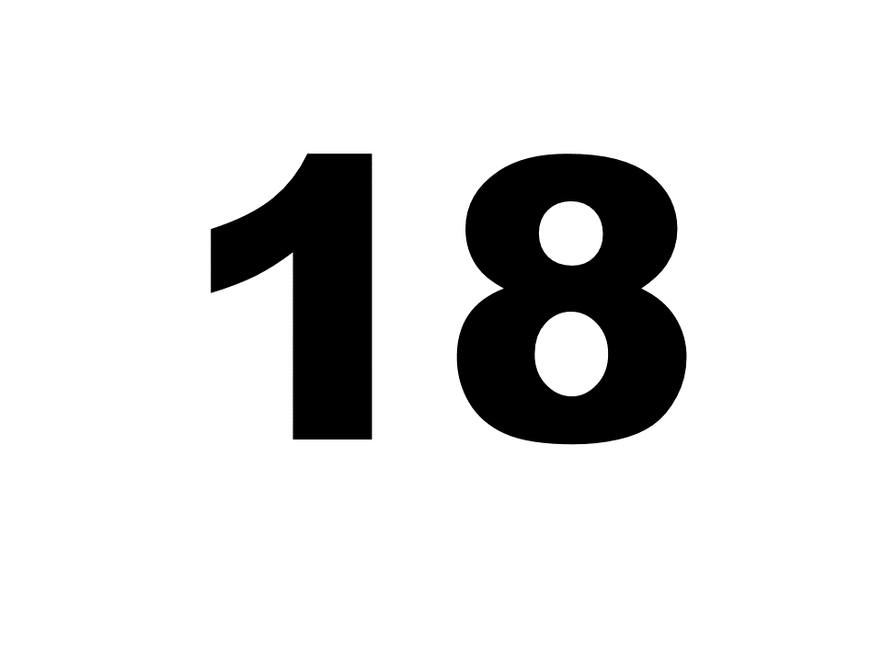
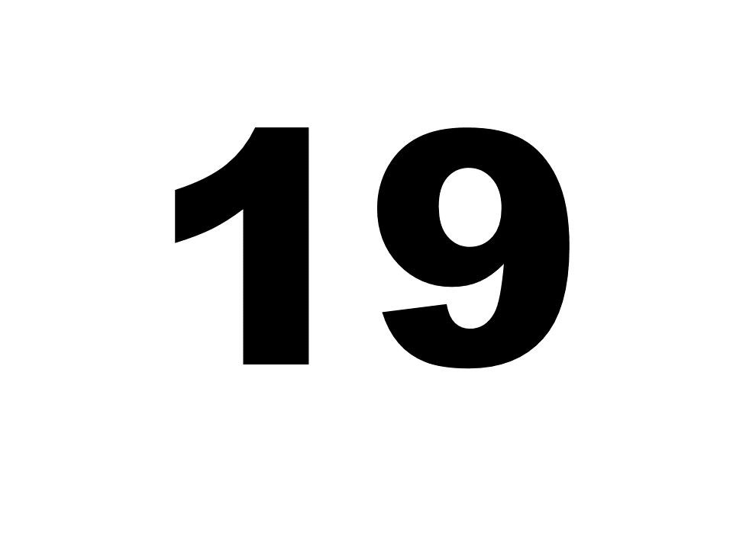
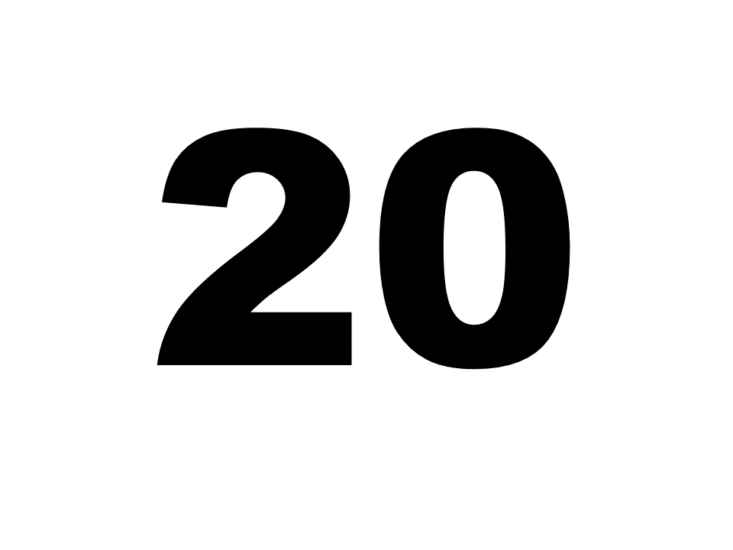
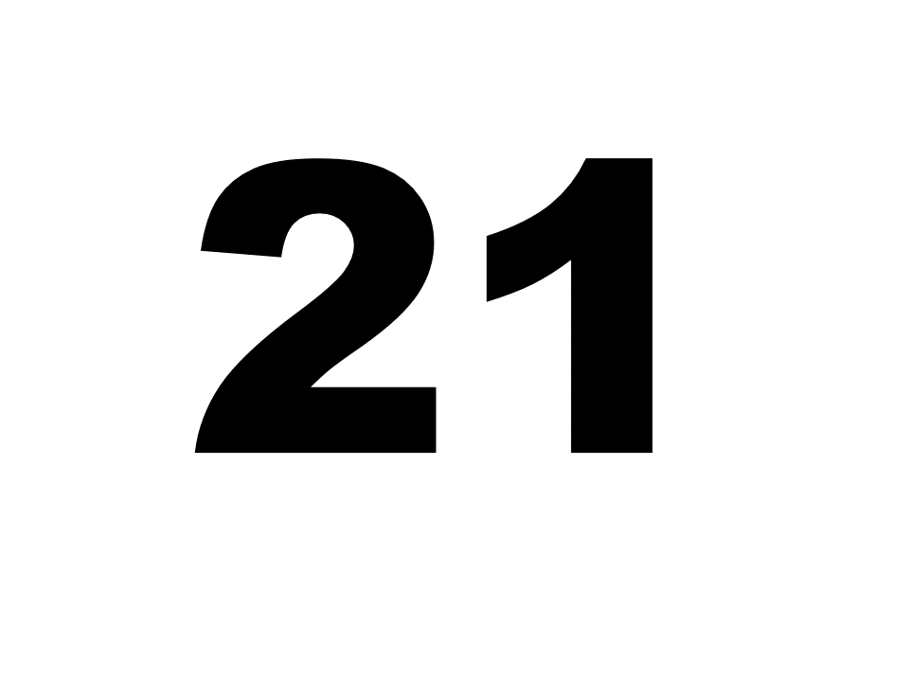
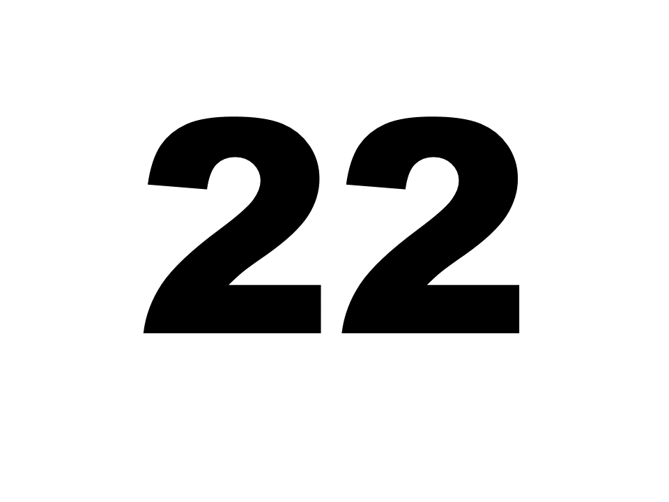
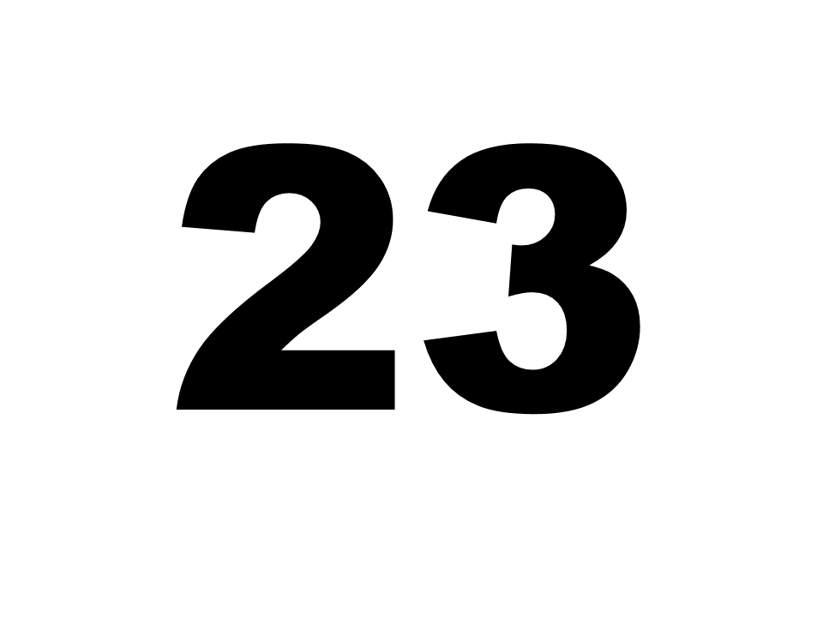
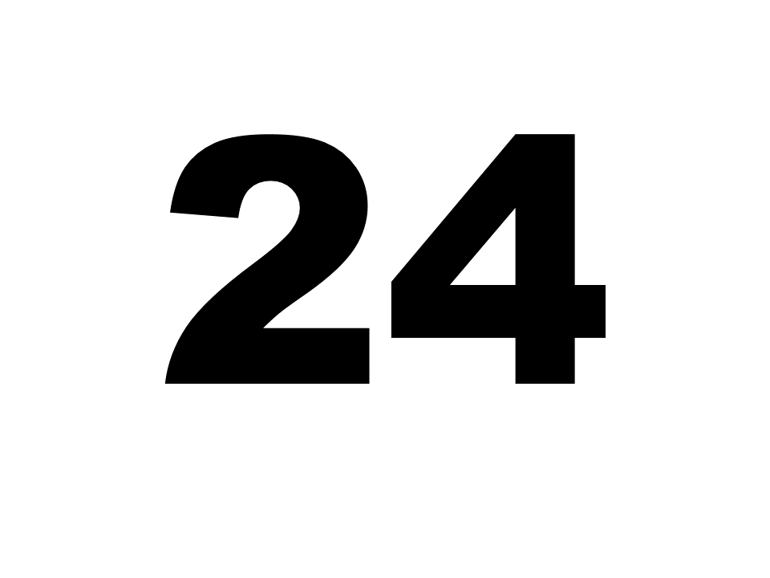
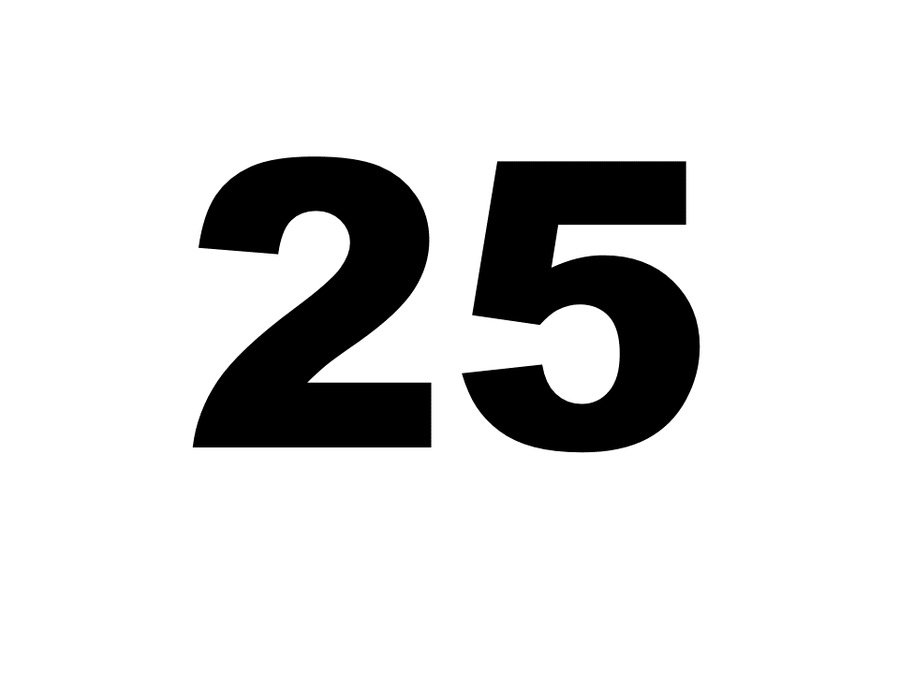
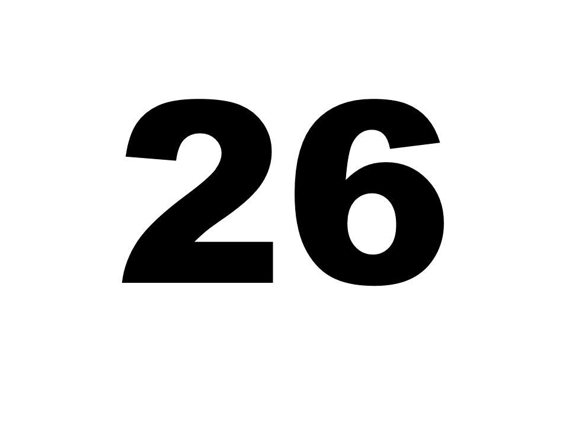
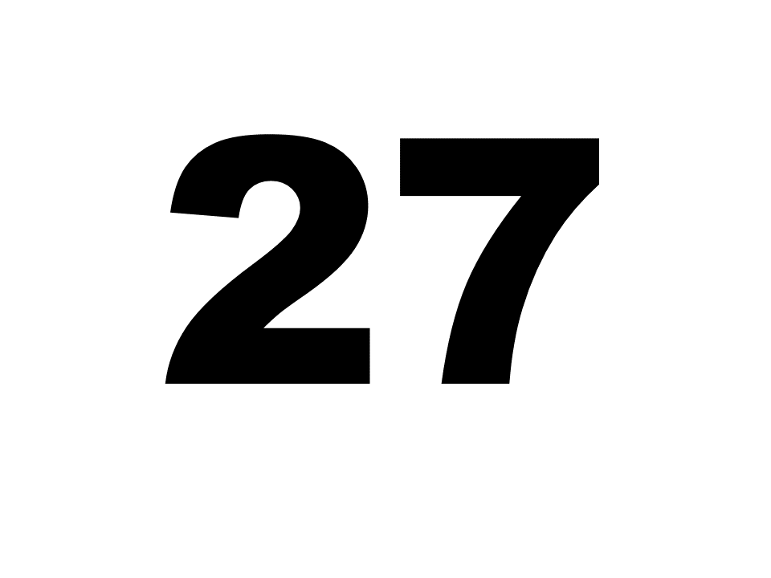
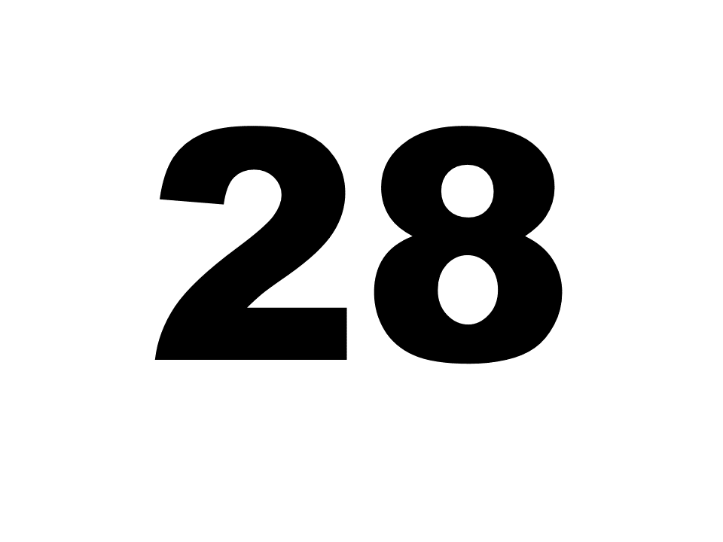
Free Classification (FC, Example: German vowels)
Instructions: Make groups of 2 or more similar-sounding vowels. Ignore the sex of the speaker.

Slide 16
Results: Free Classification
/i/ and /a:/ never grouped together = 0% grouping rate

Slide 17
Results: Free Classification

Slide 18
Results: Free Classification
Multidimensional Scaling (MDS) visualizes distances between stimuli
Best model recreation of observed distances
  Ex: X and Y grouped together 90% of the time
X
.1
Y
y
.4
u
.99
i
ø
.4
y
.99
i
u
.4
ø
.99
i
i
y
u
ø

Slide 19
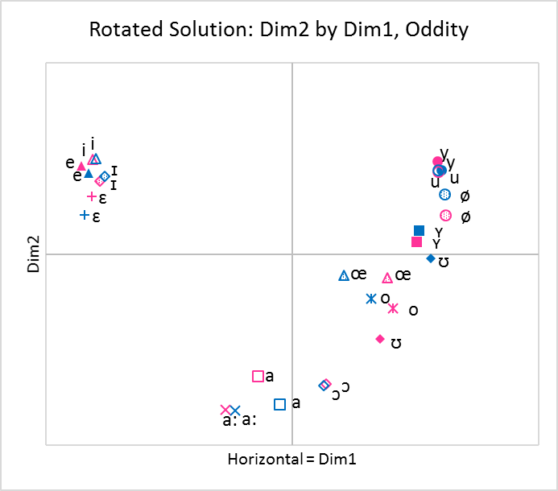
Multidimensional Scaling (MDS) Output

Slide 20
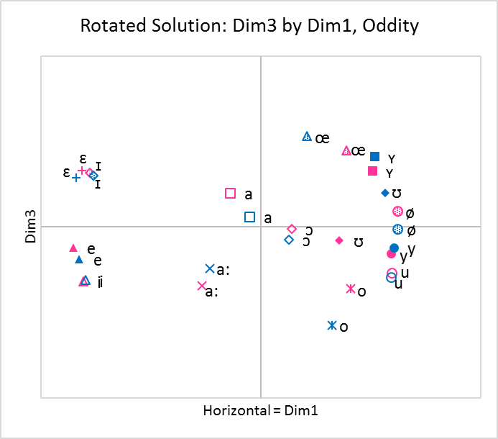
3-Dimensional Solutions
Correlations between 3-D Coordinates and Acoustic and Phonological Measures (Oddity Group)
 | f0 | F1 | F2 | F3 | Duration | dB | Gender | Roundedness | Phonological Length
Dim1 | 0.025 | -0.146 | -0.681 | -0.650 | -0.038 | 0.159 | 0.007 | 0.973 | 0.072
Dim2 | 0.112 | -0.815 | 0.517 | 0.498 | -0.133 | 0.222 | 0.026 | -0.287 | 0.314
Dim3 | 0.008 | 0.261 | 0.260 | -0.248 | -0.646 | 0.128 | -0.011 | -0.033 | -0.801

Slide 21
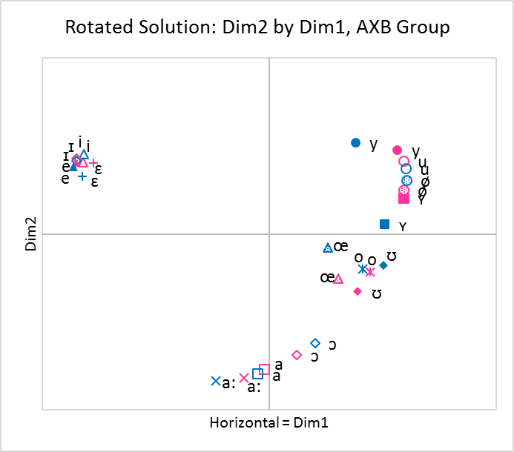
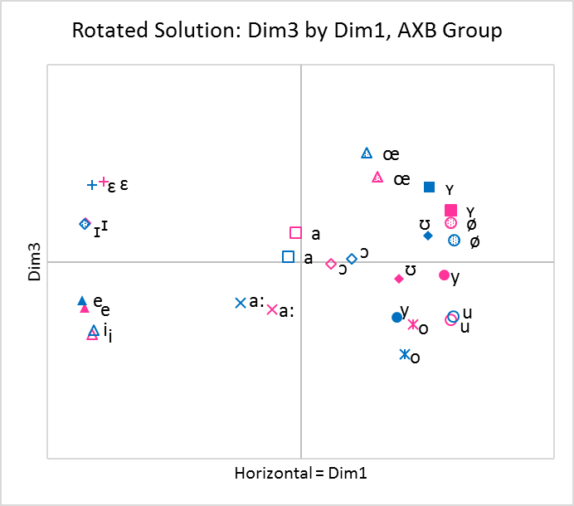
3-Dimensional Solutions
Correlations between 3-D Coordinates and Acoustic and Phonological Measures (AXB Group)
 | f0 | F1 | F2 | F3 | Duration | dB | Gender | Roundedness | Phonological Length
Dim1 | -0.010 | -0.085 | -0.716 | -0.652 | -0.014 | 0.157 | -0.021 | 0.976 | 0.061
Dim2 | 0.097 | -0.808 | 0.501 | 0.472 | -0.141 | 0.220 | 0.015 | -0.277 | 0.291
Dim3 | 0.004 | 0.344 | 0.165 | -0.325 | -0.536 | 0.076 | 0.000 | 0.034 | -0.765

Slide 22
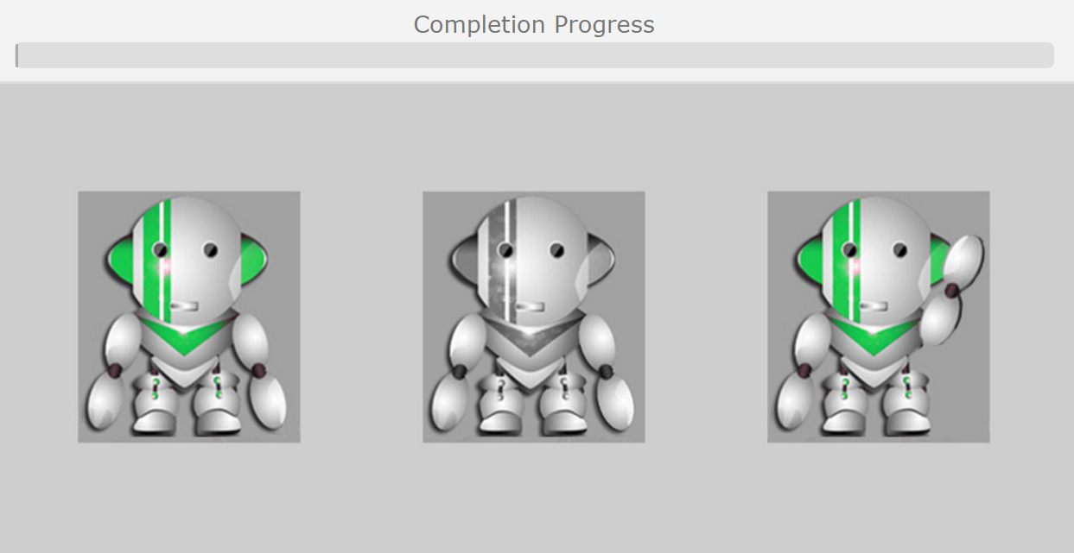
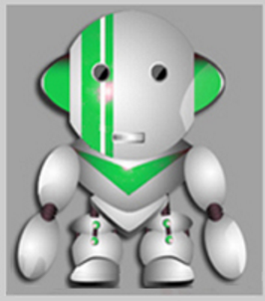
AXB
Instructions: Click on the green robot that said the same word as the grey robot. Response time is 2 seconds.
220 triads
  110 skVk
  110 ʃtVt
  ISI 1000ms
  Timeout 2500ms
speakers: 1 female, 1 male
Conducted online through jsPsych
1 | u ~ y
2 | u ~ o
3 | y ~ ø
4 | o ~ e
5 | i ~ e
6 | i ~ a
7 | ɪ ~ ɛ
8 | ɪ ~ ʏ
9 | e ~ ɛ
10 | e ~ a
11 | ø ~ ʏ

Slide 23
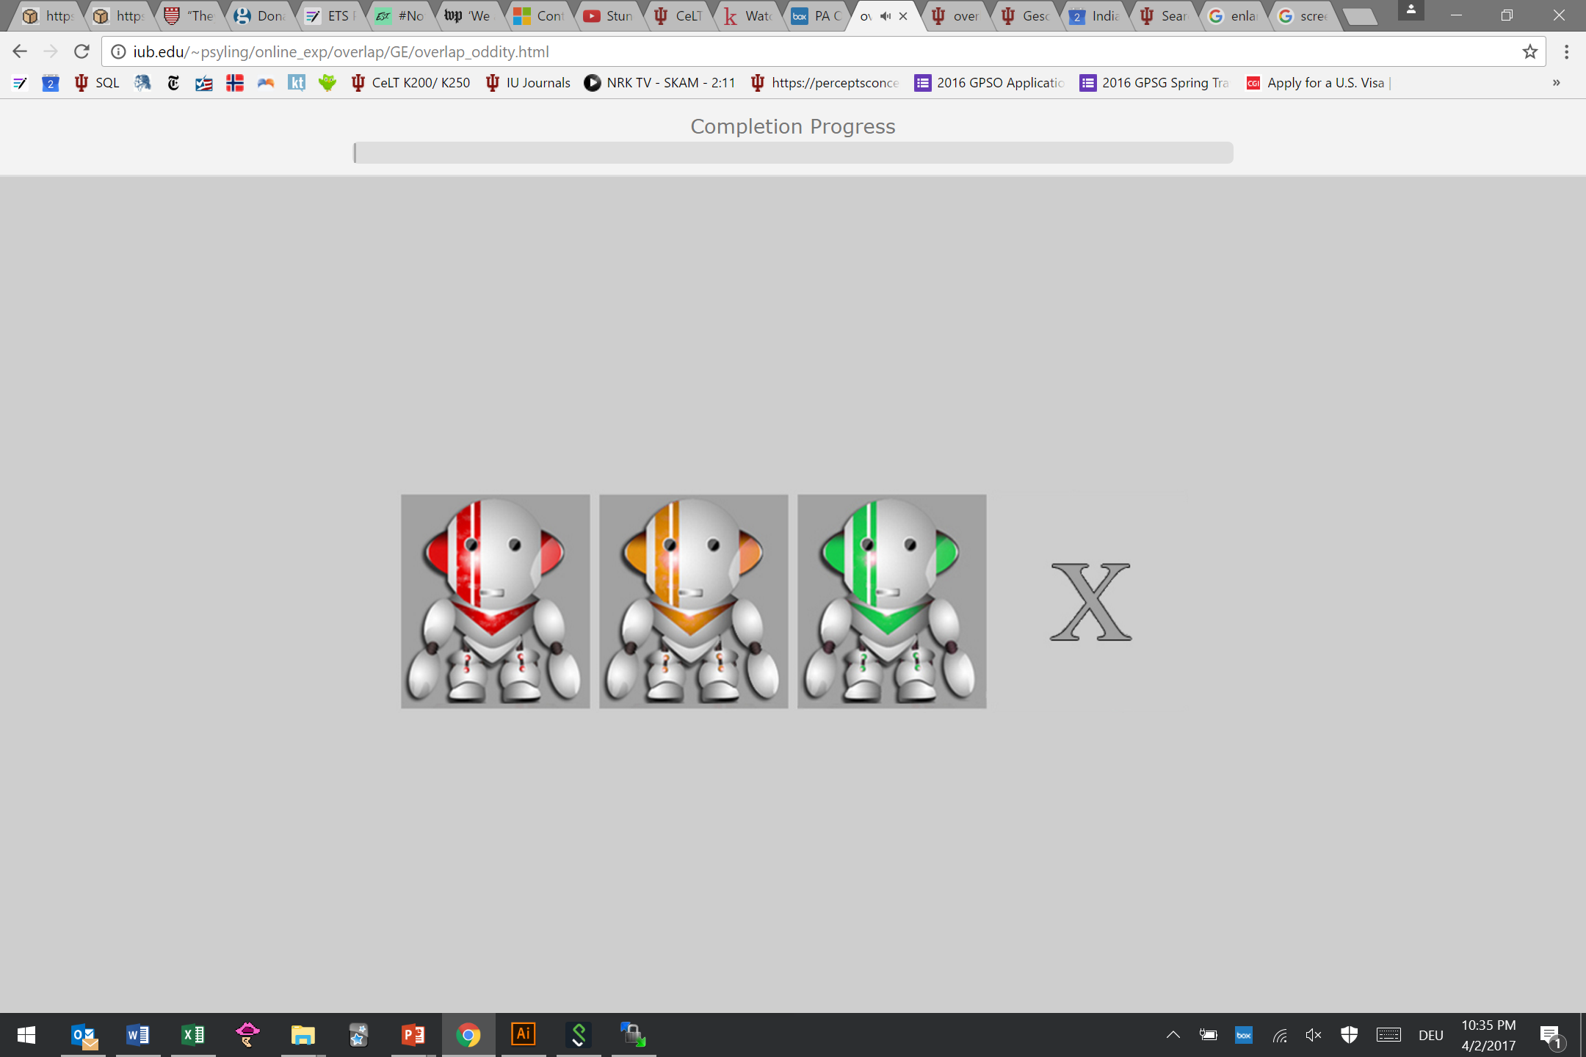
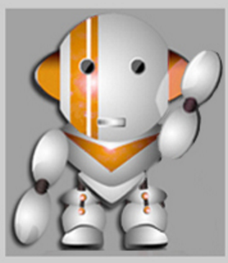
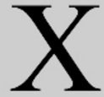
Oddity
Instructions: Click on the robot that said something different. If all say the same word, click X. Response time is 2 seconds.
3 different speakers
Conducted online through jsPsych

Slide 24
Results: Discrimination

Slide 25
Comparisons for AXB Group
 | Discrimination |  | Perceptual Assimilation |  |  |  |  | Free Classification
Contrast | AXB d’ | AXB Accuracy | PA Types at 50% Cutoff | PA Types at 70% Cutoff | PA Types at 90% Cutoff | Overlap scores | Goodness-Weighted Overlap | MDS Weighted Distances | Raw Overlap
ø ~ ʏ | 1.22 | 0.725 | 1 | 1 | 2 | 0.865 | 0.854 | 0.689 | 0.436
y ~ ø | 1.72 | 0.812 | 9 | 6 | 7 | 0.451 | 0.438 | 1.033 | 0.333
u ~ y | 2.015 | 0.852 | 2 | 3 | 1 | 0.885 | 0.809 | 0.66 | 0.489
i ~ e | 2.333 | 0.887 | 5 | 7 | 10 | 0.321 | 0.276 | 0.536 | 0.478
ɪ ~ ɛ | 2.346 | 0.887 | 9 | 11 | 7 | 0.299 | 0.281 | 0.725 | 0.444
ɪ ~ ʏ | 2.889 | 0.953 | 9 | 5 | 7 | 0.013 | 0.012 | 3.206 | 0.006
u ~ o | 2.899 | 0.948 | 5 | 7 | 4 | 0.242 | 0.226 | 1.184 | 0.272
e ~ ɛ | 2.93 | 0.952 | 5 | 7 | 4 | 0.269 | 0.23 | 1.45 | 0.186
e ~ a | 3.16 | 0.98 | 3 | 2 | 3 | 0.015 | 0.012 | 3.137 | 0.006
o ~ e | 3.2 | 0.983 | 3 | 4 | 4 | 0.004 | 0.003 | 3.241 | 0.003
i ~ a | 3.223 | 0.987 | 5 | 7 | 10 | 0.01 | 0.01 | 3.241 | 0.003
Correlation with d’ | -- | (.996) | 0.439 | 0.339 | 0.550 | -0.882 | -0.897 | 0.760 | -0.798
Most difficult
Easiest

Slide 26
German Vowels, AE Listeners
 | Discrimination |  | Perceptual Assimilation |  |  |  | Free Classification
Contrast | Oddity d' | Oddity Accuracy | PA Types at 50% Cutoff | PA Types at 70% Cutoff | PA Types at 90% Cutoff | Overlap scores | Grouping Rates
ø ~ ʏ | 0.948 | 0.54 | 1 | 15 | 2 | 0.793 | 0.379
y ~ ø | 1.302 | 0.634 | 21 | 20 | 13 | 0.384 | 0.409
u ~ y | 1.344 | 0.626 | 1 | 2 | 3 | 0.969 | 0.567
ɪ ~ ɛ | 1.919 | 0.756 | 21 | 20 | 14 | 0.258 | 0.398
i ~ e | 1.932 | 0.765 | 19 | 19 | 14 | 0.274 | 0.468
ɪ ~ ʏ | 2.293 | 0.848 | 21 | 20 | 14 | 0.066 | 0.035
u ~ o | 2.31 | 0.839 | 19 | 19 | 13 | 0.207 | 0.21
e ~ ɛ | 2.409 | 0.861 | 19 | 19 | 13 | 0.251 | 0.277
e ~ a | 2.719 | 0.923 | 12 | 12 | 12 | 0.031 | 0.011
o ~ e | 2.783 | 0.927 | 12 | 12 | 13 | 0.017 | 0.005
i ~ a | 2.904 | 0.948 | 19 | 19 | 14 | 0.014 | 0.005
Correlation with d’ | -- | 0.998 | 0.456 | 0.188 | 0.687 | 0.871 | -0.829
Most difficult
Easiest

Slide 27
Finnish Vowels, Japanese Listeners
 | Discrimination |  | Perceptual Assimilation |  |  |  | Free Classification
Contrast | Oddity d' | Oddity Accuracy | PA Types at 50% Cutoff | PA Types at 70% Cutoff | PA Types at 90% Cutoff | Overlap Scores | Grouping Rates
æ ~ ɑ | 0.237 | 0.436 | 1 | 1 | 15 | 0.860 | 0.679
y ~ ø | 1.388 | 0.652 | 19 | 19 | 13 | 0.366 | 0.094
o ~ ø | 1.568 | 0.688 | 19 | 19 | 13 | 0.201 | 0.372
u ~ ø | 1.910 | 0.738 | 19 | 19 | 19 | 0.172 | 0.343
ɑ ~ o | 2.024 | 0.764 | 21 | 21 | 13 | 0.208 | 0.191
e ~ ø | 2.098 | 0.79 | 19 | 19 | 19 | 0.102 | 0.048
e ~ æ | 2.181 | 0.81 | 21 | 21 | 21 | 0.068 | 0.087
u ~ y | 2.438 | 0.867 | 21 | 21 | 20 | 0.036 | 0.024
e ~ i | 2.806 | 0.91 | 21 | 21 | 21 | 0.019 | 0.085
ɑ ~ i | 3.151 | 0.957 | 21 | 21 | 20 | 0.000 | 0.010
Correlation with d’ | -- | 0.997 | 0.825 | 0.825 | 0.650 | -0.949 | -0.856
Most difficult
Easiest

Slide 28
Finnish Length, Japanese Listeners
 | Discrimination |  | Identification |  |  |  | Free Classification
Contrast | Oddity d' | Oddity Accuracy | PA Types at 50% Cutoff | PA Types at 70% Cutoff | PA Types at 90% Cutoff | Overlap Scores | Grouping Rates
cVVcVV-cVVccVV | -0.007 | 0.371 | 1 | 16 | 16 | 0.705 | 0.575
cVVcV-cVVccV | 0.642 | 0.511 | 21 | 21 | 14 | 0.440 | 0.512
cVVccV-cVVccVV | 0.779 | 0.613 | 21 | 19 | 13 | 0.039 | 0.155
cVcV-cVccV | 1.013 | 0.697 | 21 | 21 | 20 | 0.087 | 0.213
cVccVV-cVVcVV | 1.085 | 0.741 | 21 | 21 | 21 | 0.024 | 0.041
cVccV-cVVcV | 1.432 | 0.813 | 21 | 21 | 20 | 0.005 | 0.031
cVVcV-cVcVV | 1.594 | 0.790 | 21 | 21 | 20 | 0.014 | 0.023
cVcV-cVVcV | 1.791 | 0.837 | 21 | 21 | 14 | 0.000 | 0.014
Correlation with d’ | -- | 0.969 | .731 | .786 | .294 | -0.858 | -0.888
Most difficult
Easiest

Slide 29
Finnish Length, American English Listeners
 | Discrimination |  | Identification |  |  |  | Free Classification
Contrast | Oddity d' | Oddity Accuracy | PA Types at 50% Cutoff | PA Types at 70% Cutoff | PA Types at 90% Cutoff | Overlap Scores | Grouping Rates
cVVcVV-cVVccVV | 0.120 | 0.304 | 13 | 13 | 13 | 0.726 | 0.284
cVVcV-cVVccV | 0.482 | 0.390 | 4 | 4 | 4 | 0.917 | 0.356
cVVccV-cVVccVV | 0.664 | 0.435 | 13 | 13 | 13 | 0.536 | 0.198
cVccVV-cVVcVV | 0.847 | 0.490 | 13 | 13 | 13 | 0.294 | 0.130
cVcV-cVccV | 0.938 | 0.513 | 20 | 20 | 14 | 0.417 | 0.354
cVccV-cVVcV | 1.575 | 0.624 | 13 | 13 | 13 | 0.337 | 0.119
cVVcV-cVcVV | 1.726 | 0.629 | 13 | 13 | 13 | 0.310 | 0.019
cVcV-cVVcV | 1.978 | 0.689 | 19 | 19 | 13 | 0.187 | 0.079
Correlation with d’ | -- | 0.992 | 0.449 | 0.449 | 0.332 | -0.813 | -0.750
Most difficult
Easiest

Slide 30
Arabic Consonants, AE Listeners
 | Discrimination |  | Perceptual Assimilation |  |  |  | Free Classification
Contrast | Oddity d' | Oddity Accuracy | PA Types at 50% Cutoff | PA Types at 70% Cutoff | PA Types at 90% Cutoff | Overlap Scores | Grouping Rates
h~ħ | -0.436 | 0.222 | 8 | 8 | 8 | 0.953 | 0.521
h~x | 0.003 | 0.330 | 8 | 8 | 19 | 0.825 | 0.359
k~q | 0.212 | 0.355 | 8 | 8 | 15 | 0.765 | 0.544
ħ~x | 0.268 | 0.458 | 8 | 8 | 15 | 0.812 | 0.311
x~ɣ | 0.321 | 0.479 | 19 | 19 | 12 | 0.291 | 0.228
ɣ~ʕ | 0.568 | 0.519 | 10 | 10 | 10 | 0.449 | 0.140
h~ʕ | 0.953 | 0.617 | 18 | 18 | 18 | 0.308 | 0.071
ʕ~ʔ | 1.070 | 0.597 | 17 | 17 | 17 | 0.397 | 0.028
k~x | 1.449 | 0.789 | 21 | 21 | 19 | 0.056 | 0.046
k~h | 1.590 | 0.808 | 21 | 21 | 21 | 0.004 | 0.014
Correlation with d’ | -- | 0.985 | 0.833 | 0.833 | 0.691 | -0.912 | -0.890
Most difficult
Easiest

Slide 31
Discussion: Perceptual Assimilation
Using perceptual assimilation categorization types was challenging for several reasons
  Arbitrary cutoffs changed the nature and rank order of discriminability predictions
  Contrasts with the same categorization type often differed in discriminability (Ex: /ɪ~ɛ/ (hard) and /i~a/ (easy) were both “Two Category” assimilations)
Overlap scores were always better predictors than categorization types
Using overlap scores instead provided easily reproducible results
Separately, if we use overlap scores, we are essentially using a PA task to obtain similarity judgments

Slide 32
Discussion
C (Categorized) vs UC (Uncategorized)
UC can be further subdivided (Faris et al., 2016) into:
  UCF (Focalized): only one category was chosen more than chance
  UCC (Clustered): two or more categories chosen more than chance
  UCD (Dispersed): none above chance level
Contrast | 50% Cutoff | 70% Cutoff | 90% Cutoff
i ~ a
i ~ e
u ~ o
e ~ ɛ
ɪ ~ ʏ
C-UC
C-UC
C-UC
C-UC
2C
C-UCC
C-UCC
C-UCC
C-UCC
UCF-UCF
C-UCC
C-UCC
UCF-UCC
UCF-UCC
UCF-UCF
C-UCC
C-UCC
C-UCC
C-UCC
2C
C-UC
C-UC
C-UC
C-UC
UC-UC

Slide 33
Discussion: Free Classification
FC usually predicted discriminability slightly less well than PA overlap scores (except JP → Finnish length)
  PA has the advantage of having more trials per participant than FC
However, FC was always better than PA categorization types
  FC is usually faster than PA
  FC does not require category labels or metalanguage
  Easily usable for phenomenon that do not have L1 categories, like length for AE listeners

Slide 34
Conclusion
Perceptual similarity of non-native sounds to each other is a better predictor of discrimination than non-native to L1 categorization
  In task design, referencing L1 categories restricts the phenomena that can be examined
  In analysis, using L1 categories made the predictions less accurate
The Free Classification task and Overlap Score analysis method provide more systematic predictions for which sounds beginning L2 learners will struggle with

Slide 35

Thank you!
We would like to thank Aaron Albin, Lila Michaels, and Meg Cychosz for their help, as well as Prof. Isabelle Darcy and the IU L2 Psycholinguistics Lab for their valuable comments and feedback.
Questions? Comments?
ddaidone@indiana.edu (Danielle Daidone)

Slide 36
References
Best, C.T (1995). A direct realist perspective on cross-language speech perception. In W. Strange & J. Jenkins (eds.), Speech perception and linguistic experience: Issues in cross-language research (pp. 171-204). Timonium, MD: York Press.
Best, C., & Tyler, M. (2007). Nonnative and second-language speech perception: Commonalities and complementarities. In O.-S. Bohn & M. Munro (Eds.), Language experience in second language speech learning: In honor of James Emil Flege (pp. 13-34). Philadelphia, PA: John Benjamins.
Daidone, D., Kruger, F., & Lidster, R. (2015). Perceptual assimilation and free classification of German vowels by American English listeners. In The Scottish Consortium for ICPhS 2015 (Eds.), Proceedings of the 18th International Congress of Phonetic Sciences. Glasgow, UK: Glasgow University.
Escudero, P. (2005). Linguistic perception and second-language acquisition: Explaining the attainment of optimal phonological categorization (Unpublished doctoral dissertation). Utrecht University, The Netherlands.
Faris, M. M., Best, C. T., & Tyler, M. D. (2016). An examination of the different ways that non-native phones may be perceptually assimilated as uncategorized. The Journal of the Acoustical Society of America, 139(1), EL1-EL5.
Flege, J. E. (1995). Second language speech learning: Theory, findings, and problems. In W. Strange (Ed.), Speech perception and linguistic experience: Issues in cross-language research (pp. 233-277). Timonium, MD: York Press.
Flege, J. E., Munro, M. J., & Fox, R. A. (1994). Auditory and categorical effects on cross‐language vowel perception. The Journal of the Acoustical Society of America, 95(6), 3623-3641.
Harnsberger, J. D. (2001). On the relationship between identification and discrimination of non-native nasal consonants. The Journal of the Acoustical Society of America, 110(1), 489-503.
Iverson, P., Kuhl, P. K., Akahane-Yamada, R., Diesch, E., Tohkura, Y. I., Kettermann, A., & Siebert, C. (2003). A perceptual interference account of acquisition difficulties for non-native phonemes. Cognition, 87(1), B47-B57.
Levy, E. S. (2009). On the assimilation-discrimination relationship in American English adults’ French vowel learning. The Journal of the Acoustical Society of America, 126(5), 2670-2682.
So, C. K., & Best, C. T. (2014). Phonetic influences on english and french listeners’assimilation of mandarin tones to native prosodic categories. Studies in Second Language Acquisition, 36(2), 195-221.
Tyler, M. D., Best, C. T., Faber, A., & Levitt, A. G. (2014). Perceptual assimilation and discrimination of non-native vowel contrasts. Phonetica, 71(1), 4-21.

